Slide 1

ORDER BY
The SQL ORDER BY clause is used to sort the data in ascending or descending order, based on one or more columns.
Every column mentioned in the ORDER BY clause must also appear in the SELECT statement.
The ORDER BY keyword sorts the data in ascending order by default. To sort the records in descending order, we can use DESC keyword.
The basic syntax of ORDER BY is:
Let us consider our STUDENTS and COURSES tables and try to sort the results using ORDER BY.

Slide 2

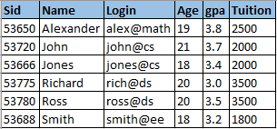

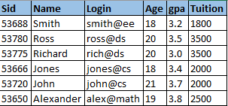
Suppose we want to list all students by their names in ascending order:
QUERY RESULT
Suppose we want to list the names in descending order:
QUERY RESULT

Slide 3

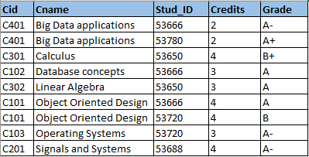
Suppose we would want to sort all the course names and student IDs in ascending order, then we can use ORDER BY on 2 columns:
QUERY RESULT
As you can see in the above result, the course names are first sorted in ascending order, then the corresponding student IDs are sorted.
If you see the original table, for course ‘Big Data applications’, student ID 53780 comes first but after sorting, ID 53666 appears first.

Slide 4

GROUP BY
The SQL GROUP BY clause is used in conjunction with the aggregate functions to arrange identical data into groups, based on one or more columns.
The GROUP BY clause follows the WHERE clause in a SELECT statement and precedes the ORDER BY clause.
Every column mentioned in the GROUP BY clause must also appear in the SELECT statement.
The basic syntax of GROUP BY is:

Slide 5

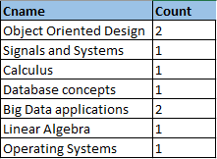
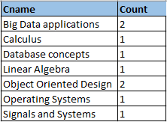

Suppose we want to know the total number of students who have taken each course. This can be achieved using GROUP BY clause as:
QUERY RESULT
We can also use ORDER BY along with GROUP BY to sort the results:
QUERY RESULT

Slide 6


If you recollect, in the previous chapter we tried to find out the name and age details of the oldest student using aggregate operators.
But we could not use non-aggregate operations in the SELECT clause unless the query contained a GROUP BY. Now, we can achieve the same result using GROUP BY as:
QUERY RESULT
GROUP BY clause is always used when there is an aggregate operator used in the SELECT clause.
GROUP BY is a powerful clause as it allows us to summarize information, which is a very important feature used in analyzing data.

Slide 7

HAVING
The SQL HAVING clause enables you to specify conditions that filter the group results obtained after the GROUP BY statement.
HAVING filters records that work on summarized GROUP BY results.
The WHERE clause places conditions on the selected columns, whereas the HAVING clause places conditions on the groups created by the GROUP BY clause.
The HAVING clause was added to SQL because the WHERE keyword could not be used with aggregate functions.
The basic syntax of HAVING is:

Slide 8

HAVING clause requires that a GROUP BY clause is present in the query.
The HAVING clause must follow the GROUP BY clause in a query and must also precede the ORDER BY clause if used.
The general syntax which includes all the 3 clauses is:
The above syntax is also called as the basic structure of an SQL query.
Let us consider our STUDENTS and COURSES tables and see how HAVING clause can be useful.

Slide 9




Suppose we want to know the name of courses which consists of at least 2 students. We can using HAVING clause to get the result:
QUERY RESULT
And suppose we want to know the age of students where there are at least 2 students with same age, then we can use HAVING:
QUERY RESULT

Slide 10

TOP/LIMIT/ROWNUM
The SQL TOP clause is used to fetch TOP N number of records from a table.
The TOP clause can be very useful on large tables with thousands of records. Returning a large number of records can impact the performance.
Not all database systems support the TOP clause. While SQL Server supports TOP, MySQL supports LIMIT clause and Oracle uses ROWNUM clause to perform the same operation.
The basic syntax of TOP is:

Slide 11


Similarly the syntax for LIMIT clause is:
And syntax for ROWNUM clause is:
Let us consider our STUDENTS table and try to retrieve the top 3 records using the 3 clauses:

Slide 12
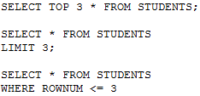

QUERY RESULT

